Slide 1

Wiztute Private Limited
Making Remote Learning - Simple & Effective

Slide 2
The Problem

Slide 3
Our Solution
Interaction
Assignments
Tests
Logistics
Students
Teachers
Classroom
VSkul - Takes care of end-to-end classroom logistics management

Slide 4
How it Works ?

Slide 5
Why Now ?

Slide 6
Market Size

Slide 7
Product

Slide 8
Business Model

Slide 9
Financial Projections

Slide 10
Competitive Landscape

Slide 11
Current Traction

Slide 12



Team

Slide 13
What we are looking for ?
$ 150K
Financing
$ 1 million
Valuation

Slide 14
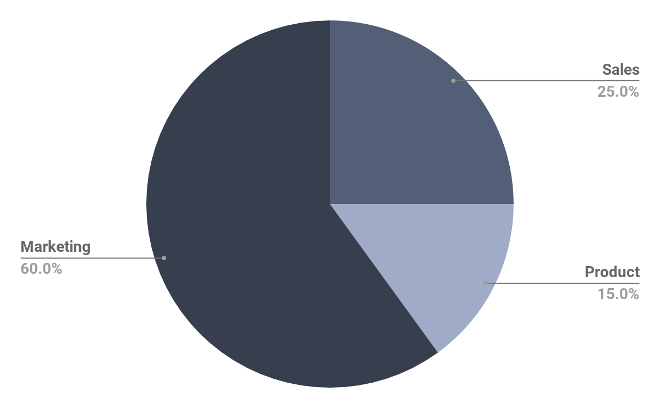
Use of Funds

